Slide 1
Desal Data Plant Charts

Slide 2
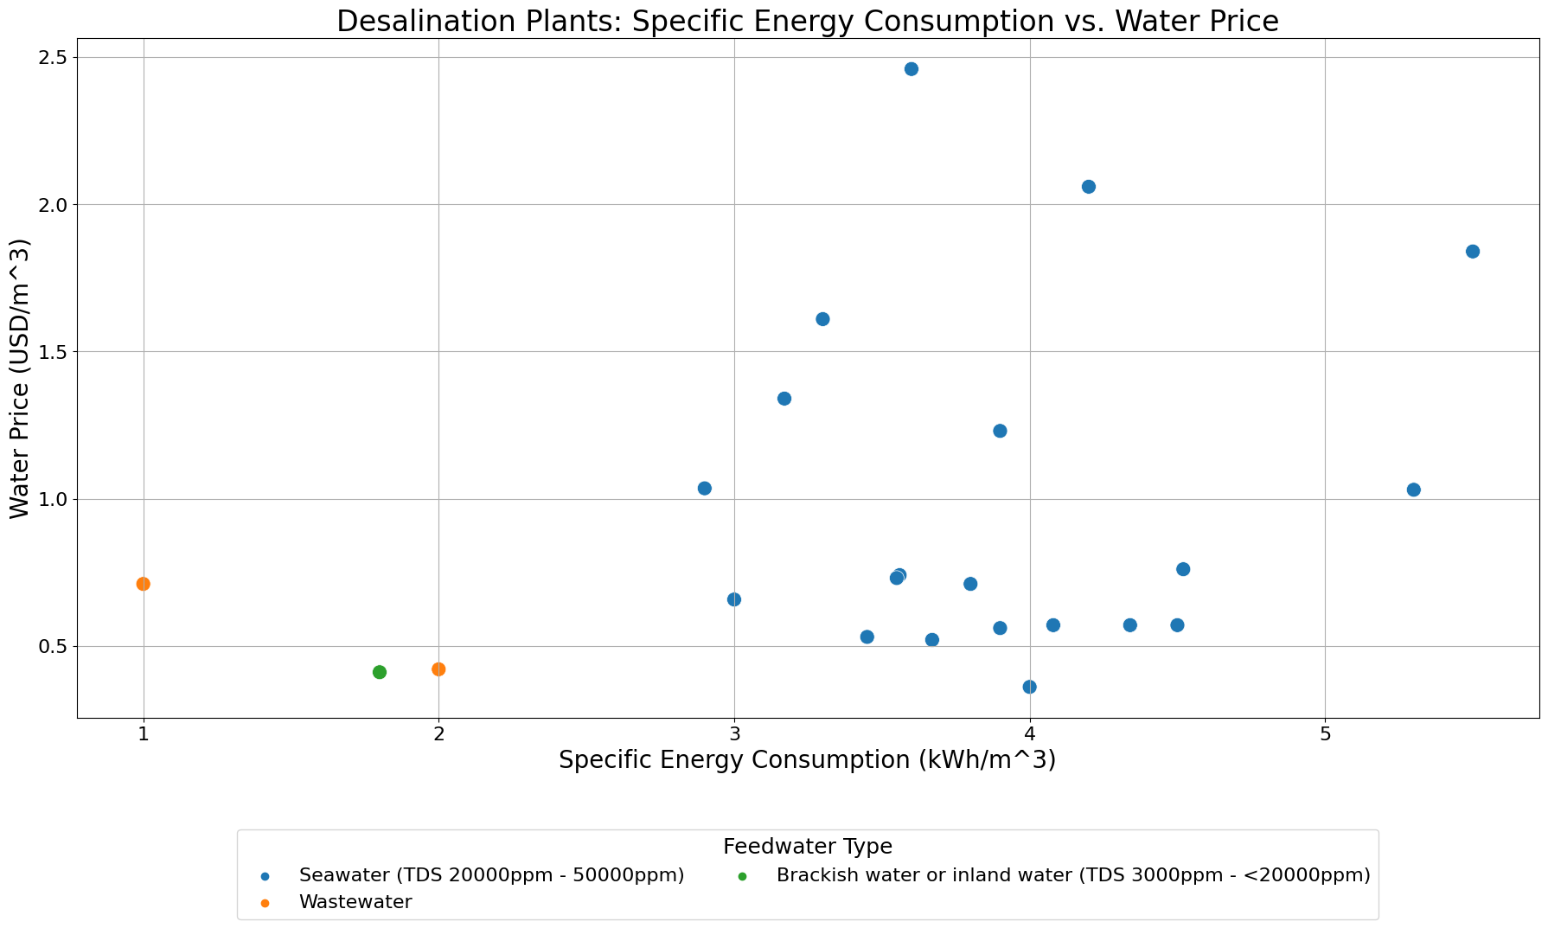

Slide 3
file:///Users/omsanan/Downloads/chart1.html

Slide 4
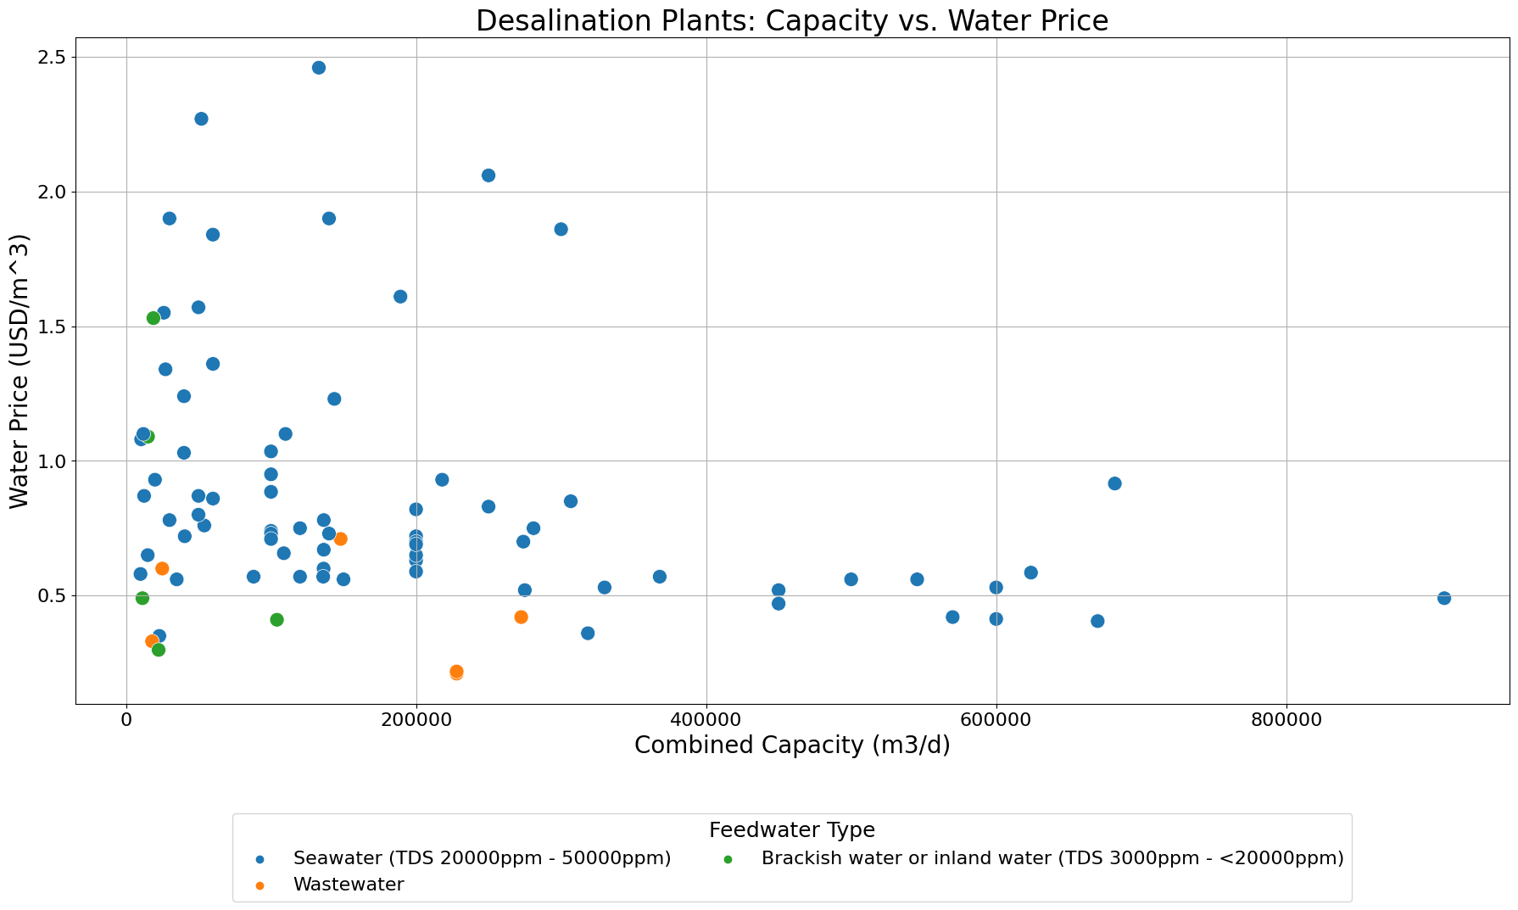

Slide 5
file:///Users/omsanan/Downloads/chart2.html

Slide 6
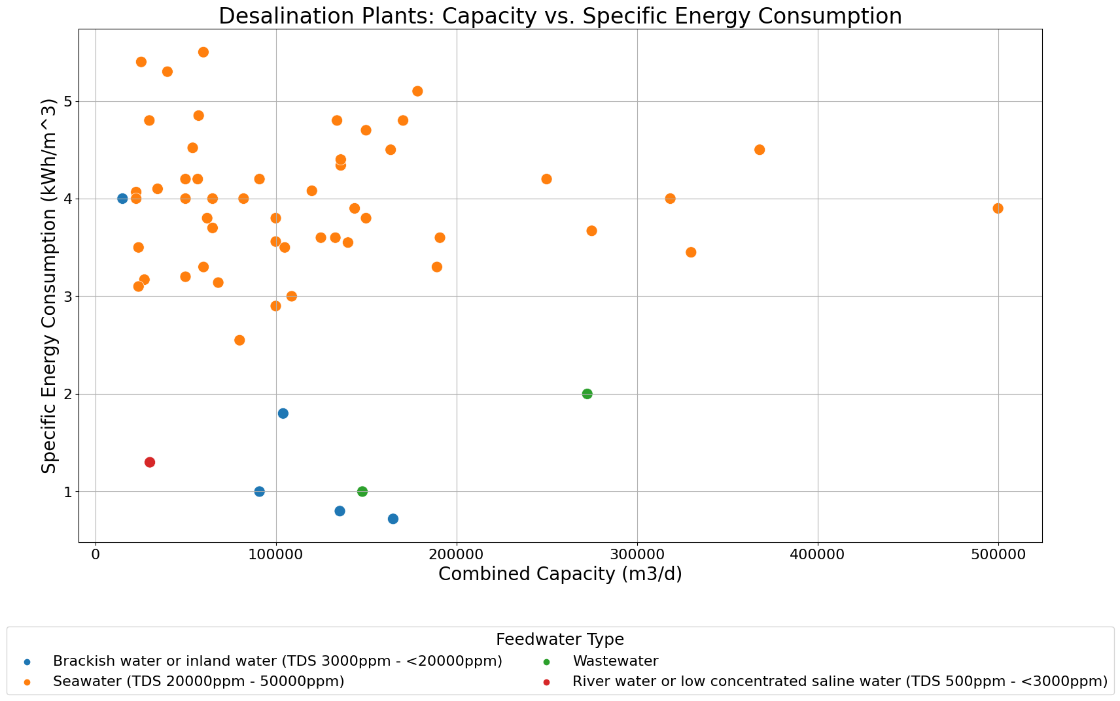

Slide 7
file:///Users/omsanan/Downloads/chart3.html

